Slide 1
PRESENTATION
BYJU’S
OSMO WORKSHEET
Krethick Chakravarthy
Game Development
Guides:-
INTERNAL : Dr Deepa V Jose
EXTERNAL: Arvind Sadasivam
1

Slide 2
TOPICS DISCUSSED:-
TOPICS | PAGE NUMBERS
PROBEMS FACED | 3
PROPOSED SYSTEM MODEL | 4-5
FUNCTIONAL AND NON FUNCTIONAL REQUIREMENTS | 6
SOFTWARE AND HARDWARE REQUIREMENTS | 7
SYSTEM MODEL | 8
SYSTEM DESIGN | 9-10
DATA FLOW DIAGARMS | 11-13
ARCHITECTURAL DESIGN | 14-15
DATABASE | 16
BENIFITS | 17
PROGRESS | 18
REFERENCES AND CONCLUSION | 19-20

Slide 3
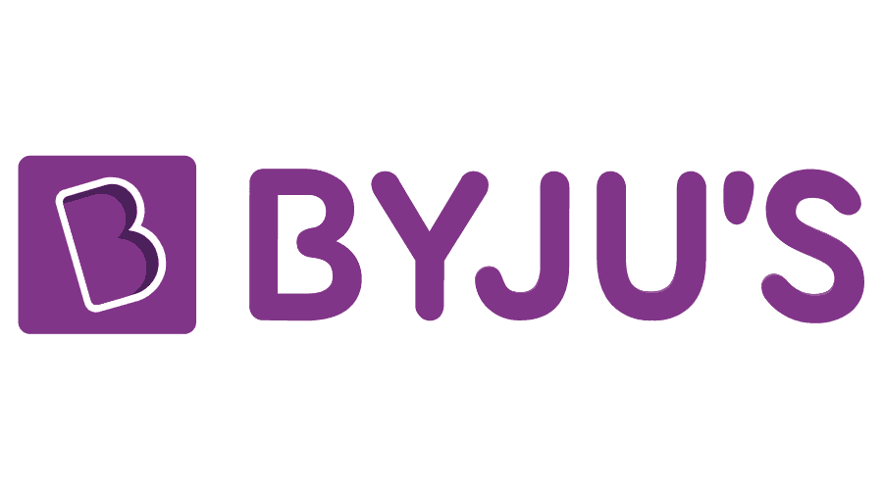
Byju's' app was developed by Think and Learn Pvt Ltd, established by Byju Raveendran in 2011. Byju’s has acquired Osmo, a Palo Alto-based education startup. ‘Osmo Worksheets’.
These are interactive worksheets for kids in and below Grade 3. These worksheets are programmed and validated based on user gameplay. Each time the player successfully accomplishes the objective and wins, the system will learn to take advantage of the winning strategy, and the game will continue with a new objective to be achieved and a now slightly harder task.
The game consists of multiple worksheets. Each time the player completes a certain worksheet, he/she goes to the next state.Coding in Unity is done through C#. Every action that takes place in the game has to be triggered using a C# script.

Slide 4

INTRODUCTION
Byju's' app was developed by Think and Learn Pvt Ltd, established by Byju Raveendran in 2011.
Byju’s has acquired Osmo, a education startup. ‘Osmo Worksheets’.
These are interactive worksheets for kids in and below Grade 3. These worksheets are programmed and validated based on user gameplay.

Slide 5
PROBEMS FACED BEFORE:-
Adult Supervision Required all the time.
Evaluation is time consuming.
Too much stress.
Learning becomes boring.

Slide 6




PROPOSED
SYSTEM MODEL
o Character Guidance
o Auto Correction
o Hint System
Candy Crush

Slide 7



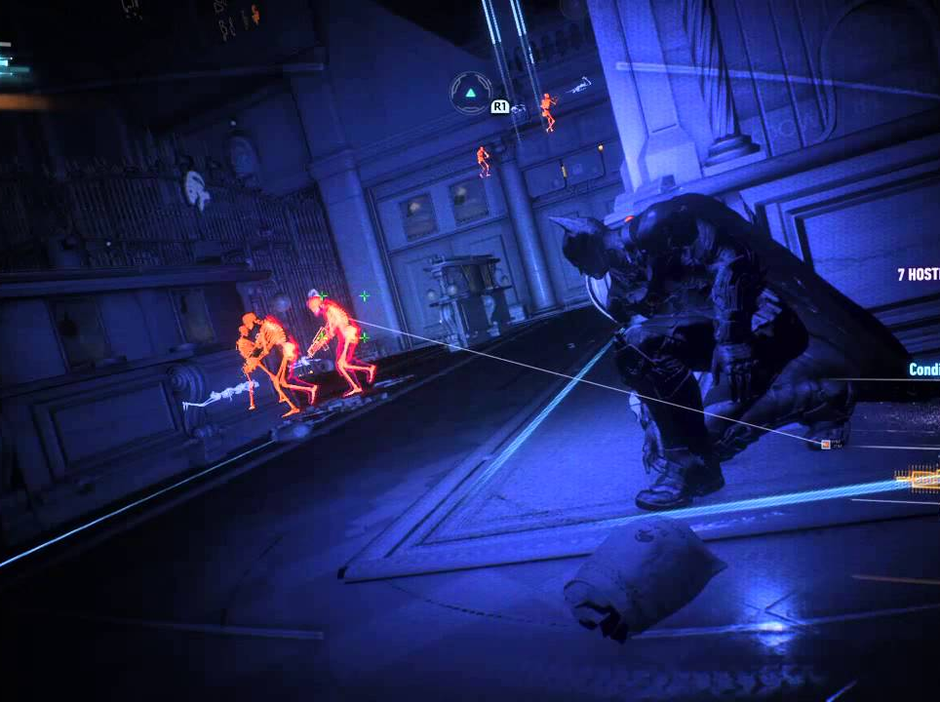
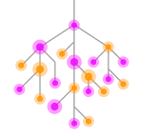

PROPOSED
SYSTEM MODEL
VARIOUS TYPES OF
MAZE GAMES
o Objective:
Help children’s solve worksheets with the help
of interactive guidance system(Character) and hint mechanics.

Slide 8


FUNCTIONAL REQUIREMENTS
1) Player
2) Jane
3) Progress
4) Achievements
5) Settings
6) Hint System
NON-FUNCTIONAL REQUIREMENTS
1) Replayability
2) Frame rate
3) Speedy response time
4) Required resources
5) Platform
6) Maintainability

Slide 9

SOFTWARE AND HARDWARE REQUIREMENTS
HARDWARE
Processor: MediaTek
Storage : Space 4 GB
RAM: 2 GB
SOFTWARE
Operating System: Android 7.0
PROGRAMMING LANGUAGE AND ENGINE
C#
Unity
Bolt

Slide 10
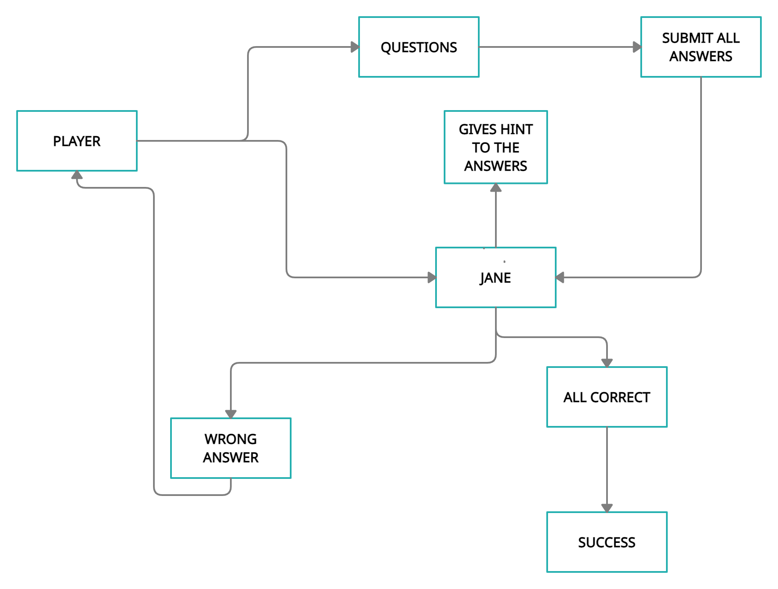
BASIC UNDERSTANDING. SYSTEM MODEL.

Slide 11
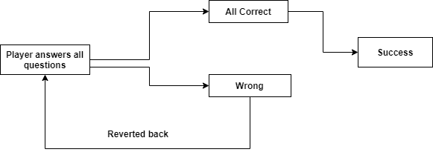
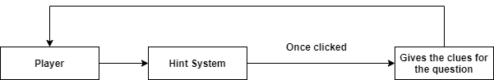
SYSTEM DESIGN (Part 1)

Slide 12
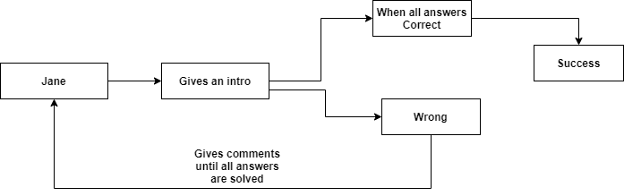
SYSTEM DESIGN (Part 2)

Slide 13
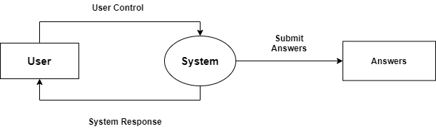
DATA FLOW DIAGRAMS
LEVEL 0:

Slide 14
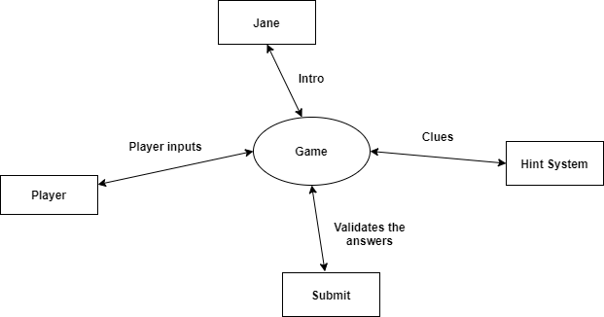
DATA FLOW DIAGRAMS
LEVEL 1:

Slide 15
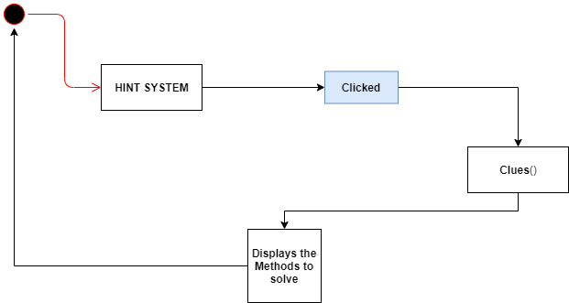
DATA FLOW DIAGRAMS
LEVEL 2:

Slide 16
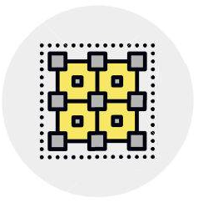
ARCHITECTURAL DESIGN
Represents the structure of data and program components that are required to build the software. (Tier-ed architecture)
4-tier Architecture in use:
Presentation layer (PL)
Data service layer (DSL)
Business logic layer (BLL)
Data access layer (DAL)

Slide 17
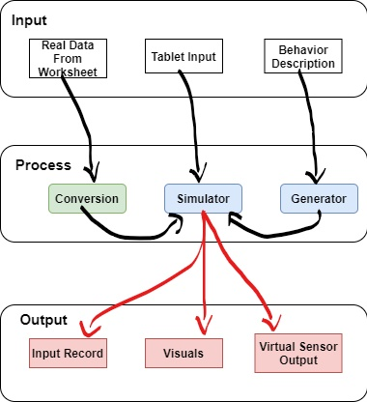
THREE-TIER ARCHITECTURE

Slide 18
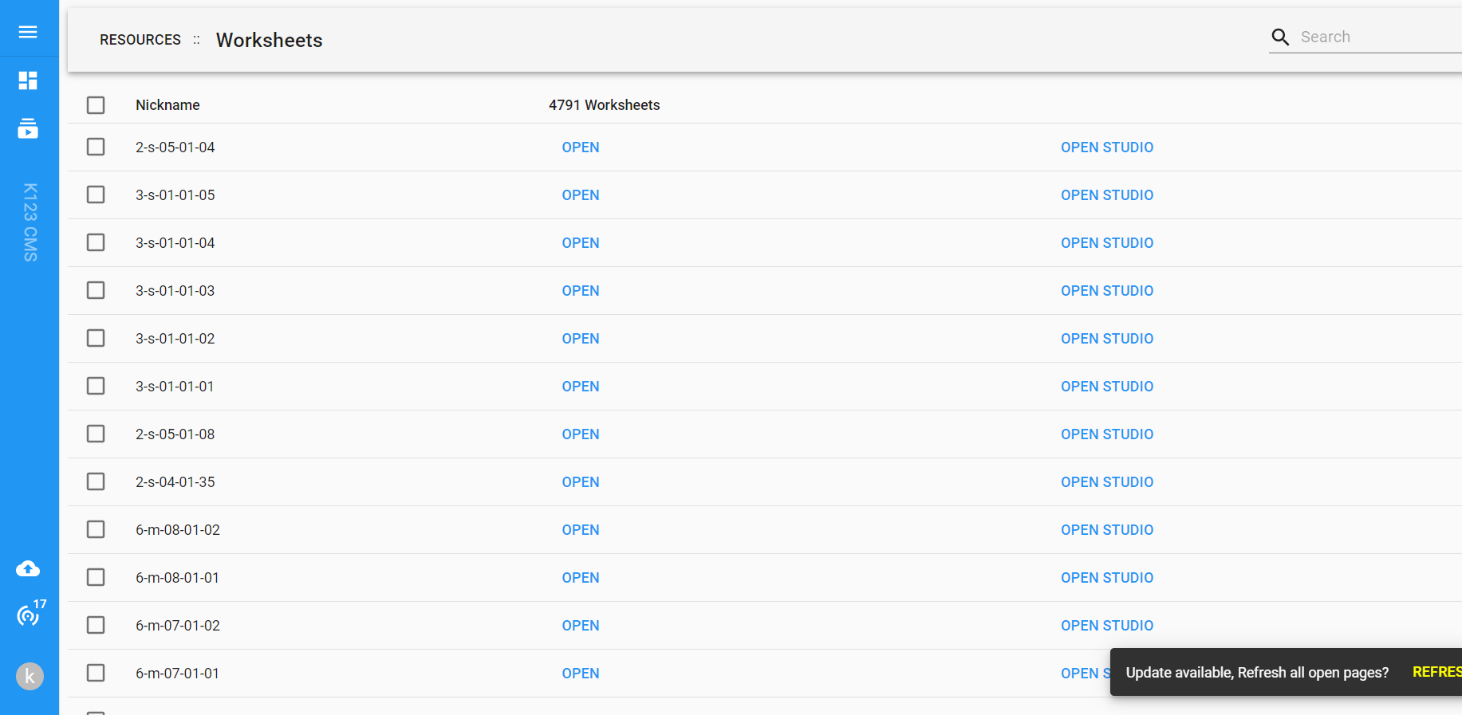
DATABASE
o As it is a game development project we don’t work on DB design or ER diagrams.
o But we use cms to
access different worksheets
for implementation.

Slide 19
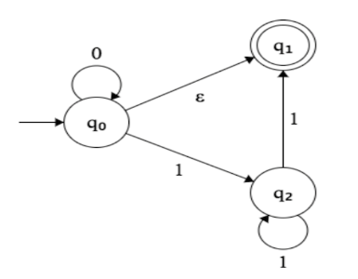
Finite State Machines: -
It is called Finite State automation.
It is a computational model that can be implemented with Software & Hardware.
It can be used to simulate sequential logic and some computer programs.
Transition: -
The process or a period of changing from one state or condition to another.

Slide 20
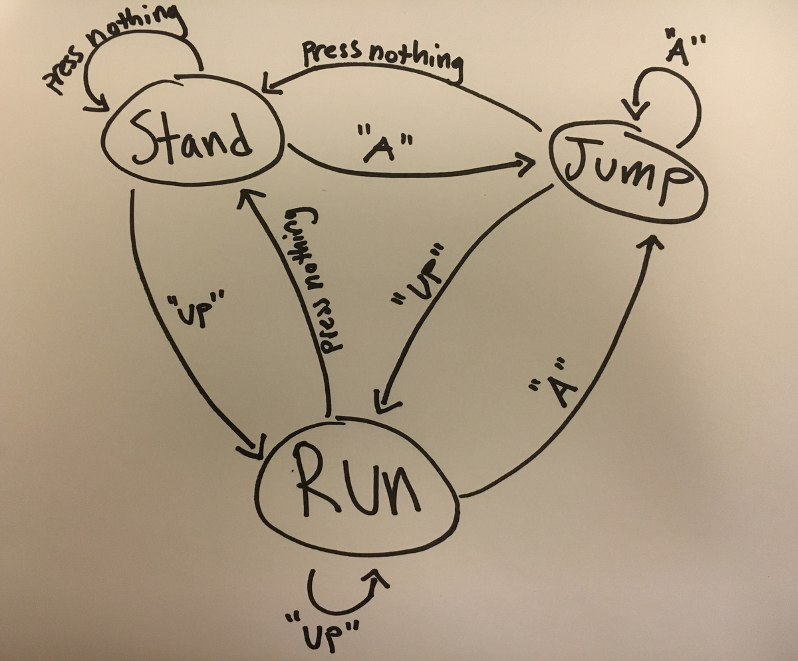
SAMPLE EXAMPLE HOW FSM WORKS

Slide 21
BOLT FRAMEWORK: -
Bolt is a visual scripting solution for use within Unity. Bolt is used to develop and work on your application without having to write code.
It helps all team members create scripting logic with visual, drag-and-drop graphs instead of hand-writing code.
Artists and designers can get more done in the editor without requiring help from programmers, and it can help programmers quickly implement ideas for faster prototyping and iteration.
Non-programmers can also make use of node graphs created by more technical team members.

Slide 22
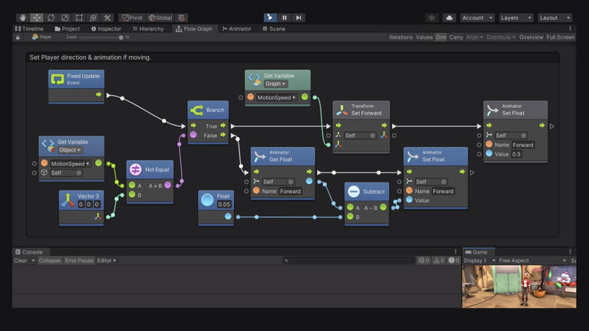
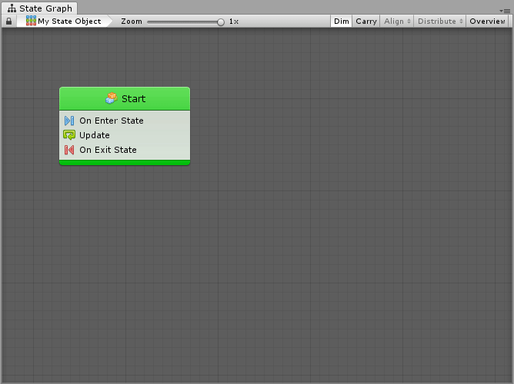
BOLT FRAMEWORK

Slide 23
BENIFITS
o Learning becomes interactive
o Guidance/hint system helps the child to solve questions easier.
o Different worksheets with different problems.
o Learning becomes entertaining

Slide 24
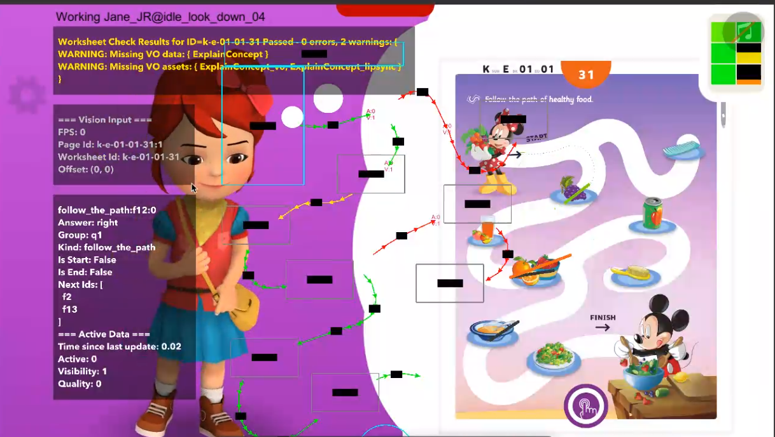
PROGRESS 1

Slide 25
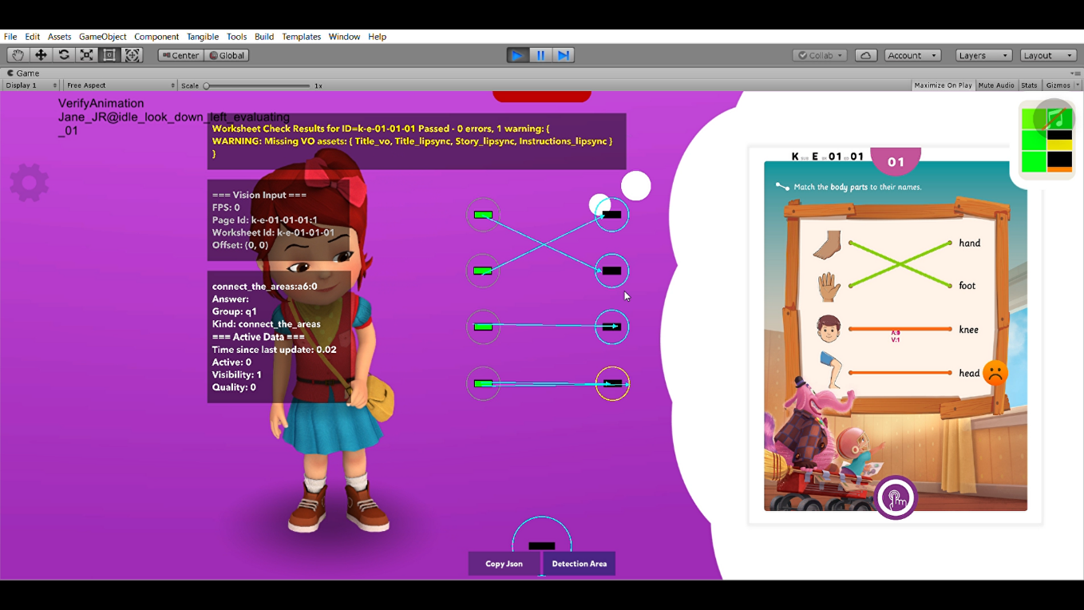
PROGRESS 2

Slide 26
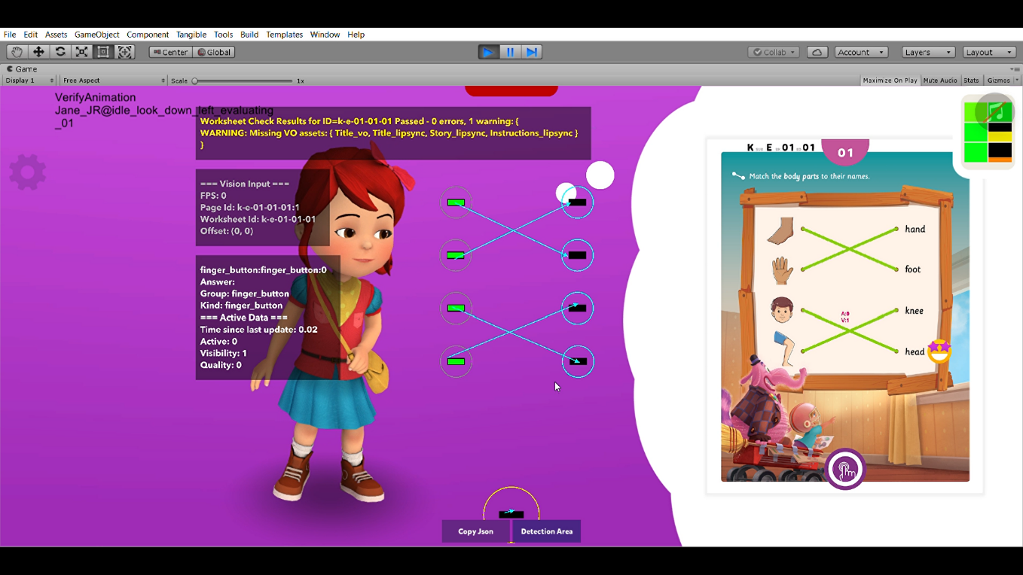
PROGRESS 3

Slide 27
REFRENCES:-
https://app.creately.com/diagram/2MvVtNFizqr/edit
https://app.diagrams.net/
https://www.patreon.com/posts/32320915

Slide 28

THANK YOU

